Slide 1


Introduction to Accessibility
Erissa Duvall – November 2023 – TechBash

Slide 2
Disclaimer
While I may mention some examples from current/past jobs, I am not representing any of my employers during this presentation.
Additionally, while I will discuss some legislation, I am not a lawyer and nothing I say should be taken as definitive legal advice.

Slide 3
Overview
What is Accessibility?
What is Disability?
Why?
How to decide what is Accessible?
Building A11y Test Plans
Tools & Resources

Slide 4
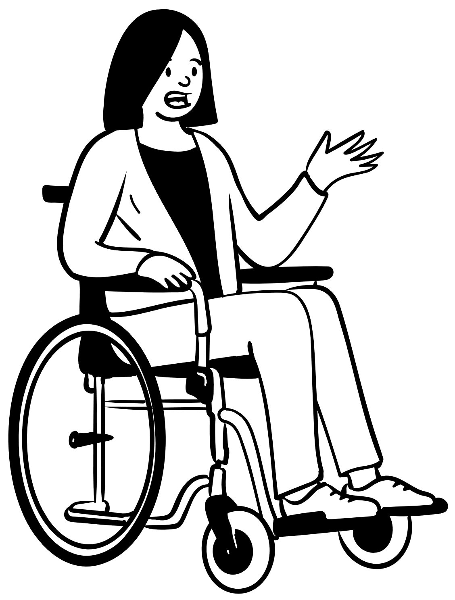
What is Accessibility?
Accessibility
Disability
Assistive / Adaptive Technology
A11y
Notes:
Accessibility – how well can your product be used by people of all abilities?
Disability – A disability is basically a mismatch in interaction between a person’s body and the features of their environment in which they live.
Adaptive/Assistive Technology (AT) - is any item, piece of equipment, software program, or product that is used to increase, maintain, or improve the functional capabilities of people with disabilities.
A11y – a commonly accepted numeronym for Accessibility that stands for the fact that Accessibility starts with an “A”, ends with a “Y” and has 11 characters in between.

Slide 5
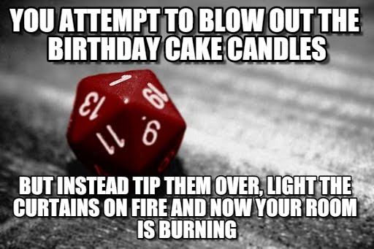
What is Disability?
Disabilities can affect people in different ways:
What part of their life does it affect?
Ability to eat
Ability to breathe
Ability to walk, stand, or lift
Ability to interpret information
Ability to see or hear
Ability to care for themselves
Visibility of the disability
When does it affect them? (temporary, permanent, situational)

Slide 6


What is Disability? (Continued)
Medical Model
Social Model
Notes:
Jeremy Andrew Davis has awesome videos describing the differences between the Social and Medical models:
Jeremy Andrew Davis on Instagram: https://www.instagram.com/jeremyandrewdavis/

Slide 7



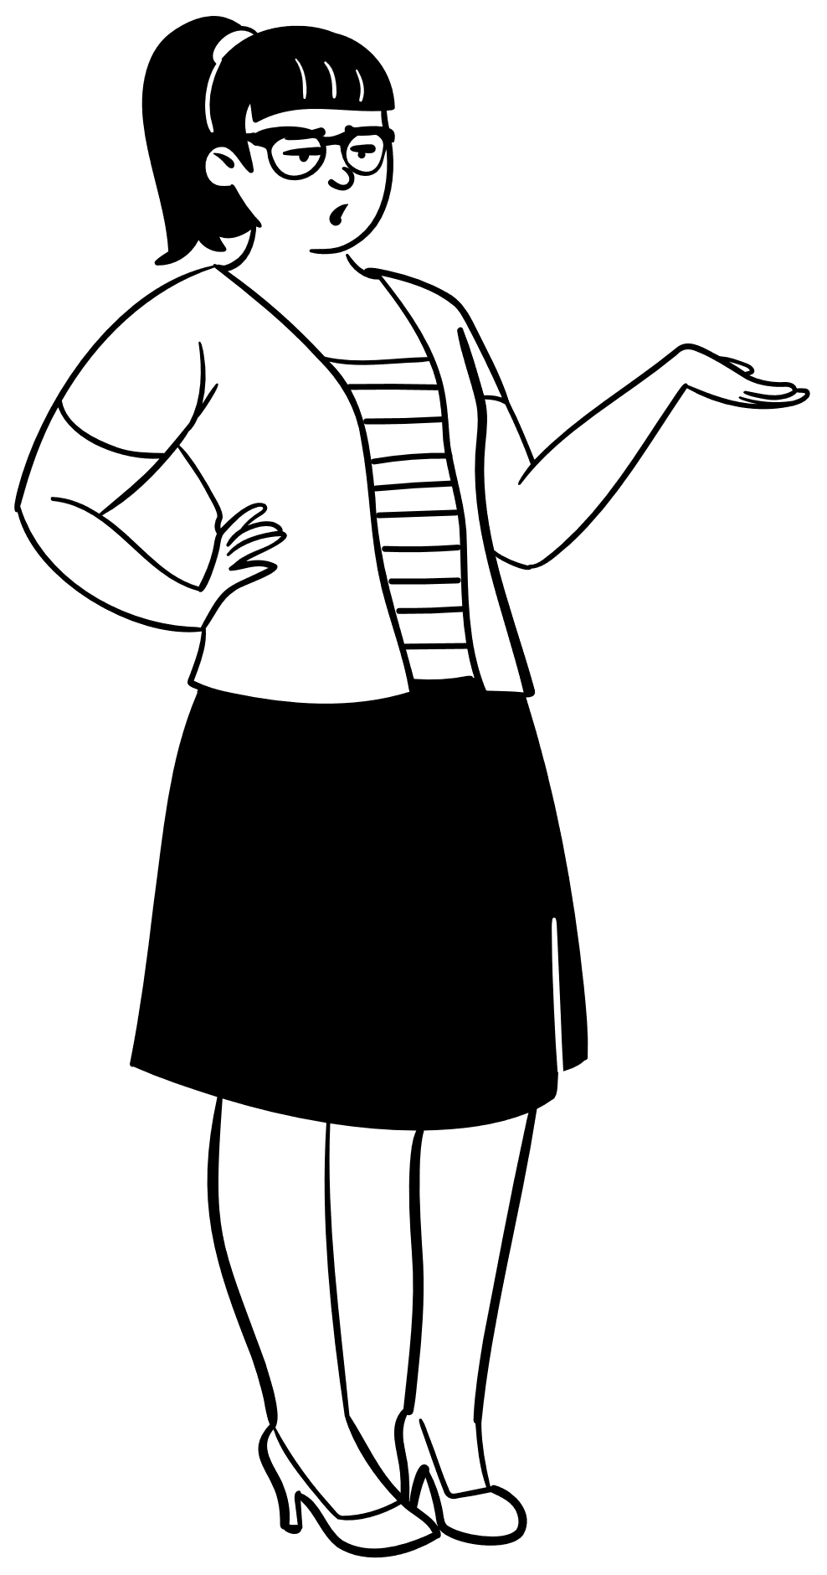
Why?
Accessibility helps to:
Remove barriers
Allow equal access
Through that we create an environment that:
Feels more welcoming
Encourages diversity
Helps people make informed decisions
Encouraging innovation / productivity / progress
Expand our market / audience
Notes:
By creating an experience where people can all access the same information and services, we remove barriers. Through that help everyone:
make more informed choices for themselves and their communities
feel more welcome (employee/customer retention)
encourage diversity in our communities and workplaces
encourage innovation and progress
avoid missing out on the market
A Hidden Market: The Purchasing Power of Working-Age Adults With Disabilities | American Institutes for Research (air.org)
Article URL: https://www.air.org/resource/report/hidden-market-purchasing-power-working-age-adults-disabilities
`The total disposable income for U.S. adults with disabilities is about $490 billion, which is comparable to other significant market segments, such as African Americans ($501 billion) and Hispanics ($582 billion). (Disposable income is what is left after taxes are paid.); and Discretionary income for working-age people with disabilities is about $21 billion, which is greater than that of the African-American ($3 billion) and Hispanic ($16 billion) market segments, combined. (Discretionary income is the money remaining after deducting taxes, other mandatory charges, and spending on necessities, such as food and housing.”

Slide 8


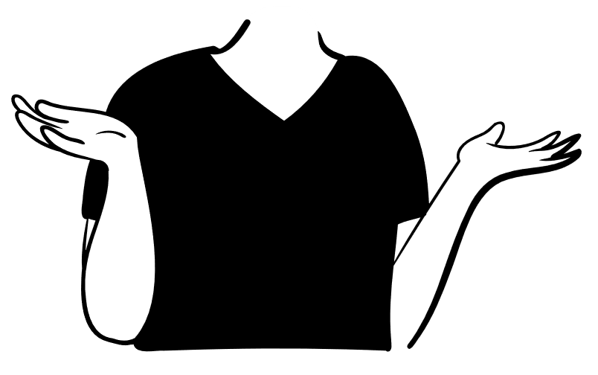
How to decide what is accessible?
Guidelines
Web Content Accessibility Guidelines (WCAG)
Authoring Tools Accessibility Guidelines (ATAG)
User Agent Accessibility Guidelines (UAAG)
Accessible Rich Internet Applications (ARIA)
Accessible Electronic Documents Community of Practice (AED COP)
Regulations
Americans with Disabilities Act (ADA)
Section 508 of the Rehabilitation Act of 1973 (USA)
Section 255 of the Communications Act (USA)
Accessibility for Ontarians Act (AODA)
Learn more at: Web Accessibility Laws & Policies | WAI | W3C
Experience
User Feedback

Slide 9
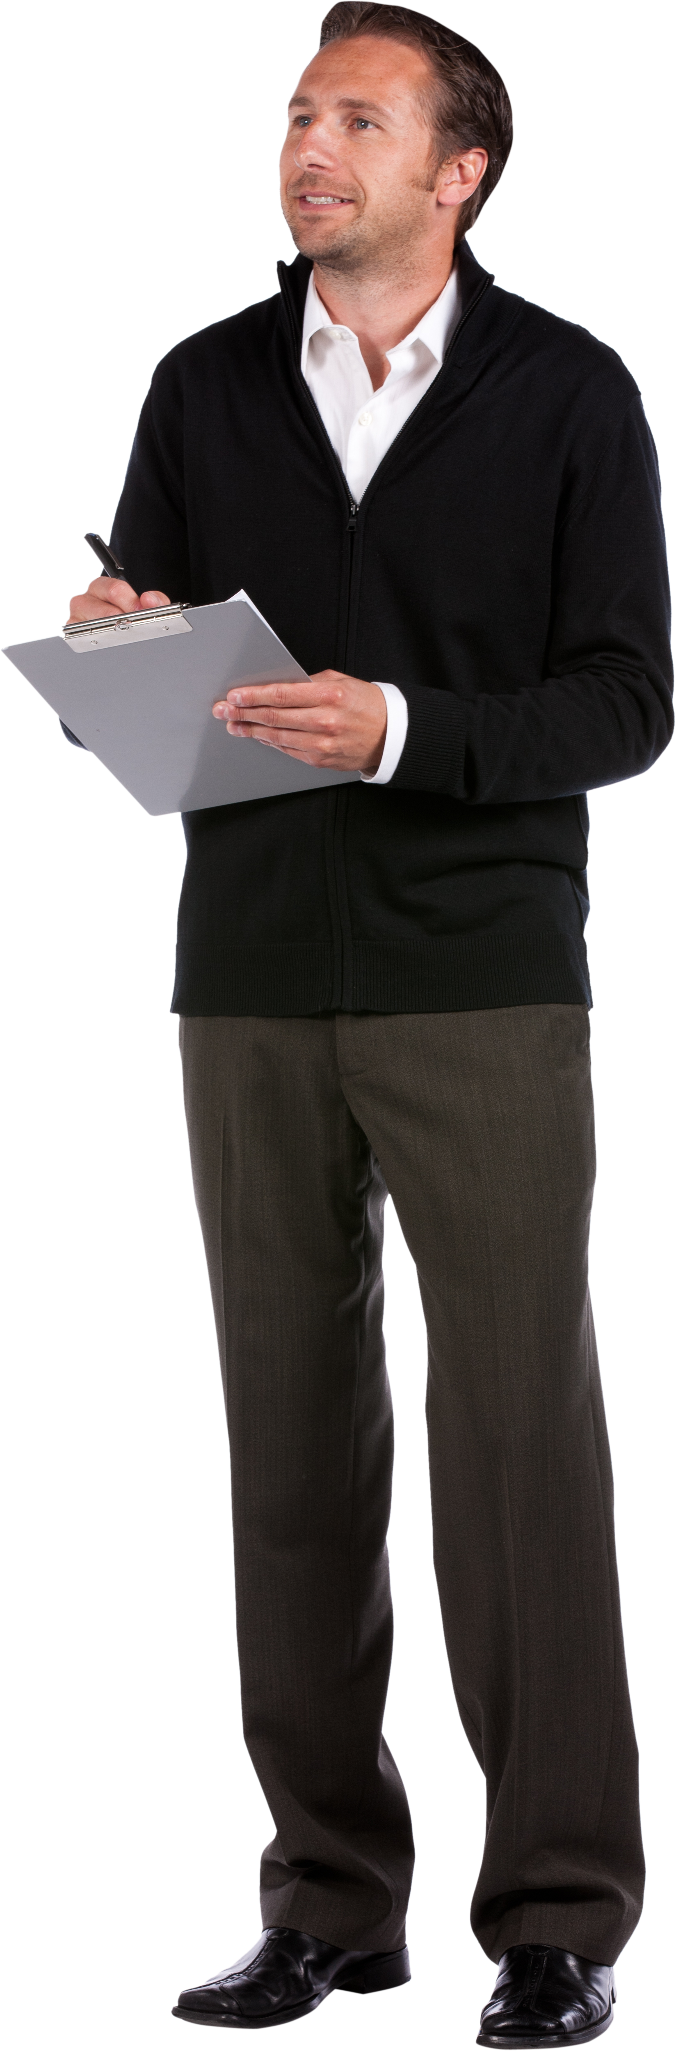
What can we do?
Shift left
Speaking up
Manual and Automated testing
Nothing without us
Respectful, people-first language
Follow best practices and guidelines

Slide 10
Resources
Microsoft Accessibility on Twitter at @MSFTEnable and at on the Microsoft Accessibility page.
Microsoft Accessibility Fundamentals course
ANDI – Bookmarklet developed by the Social Security Administration to aid in accessibility testing.
VGAR – Visa Global Accessibility Requirements
Section 508 ICT Testing Baseline for Web - This Baseline identifies the minimum requirements of any test process used to determine conformance of web content with the Revised Section 508 of the Rehabilitation Act of 1973, as amended (29 U.S.C. 794d).
Trusted Tester: Section 508 Conformance Test Process for Web – A standardized approach for manual inspection of web content for conformance with the revised Section 508 Standards.
IT Accessibility Laws and Policies | Policy & Management | Section508.gov – A page maintained by the GSA that provides information on some Accessibility related laws and policies
Web Accessibility Laws & Policies | WAI | W3C – Lists some United States governmental policies, regulations, and standards related to web accessibility.

Slide 11
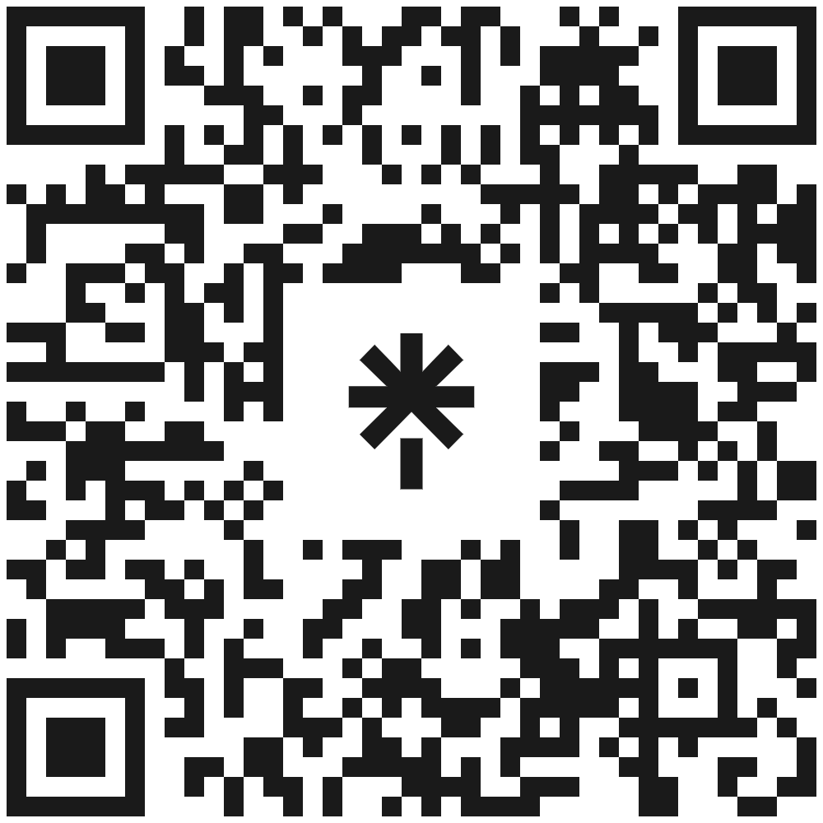
Thank You!
Questions?
linktr.ee/corgidev

